Slide 1
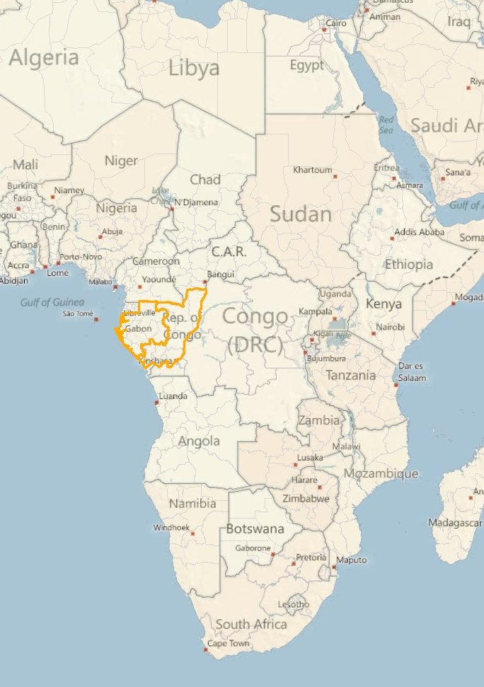
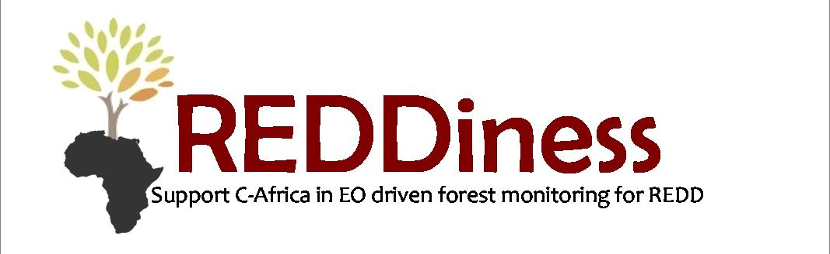

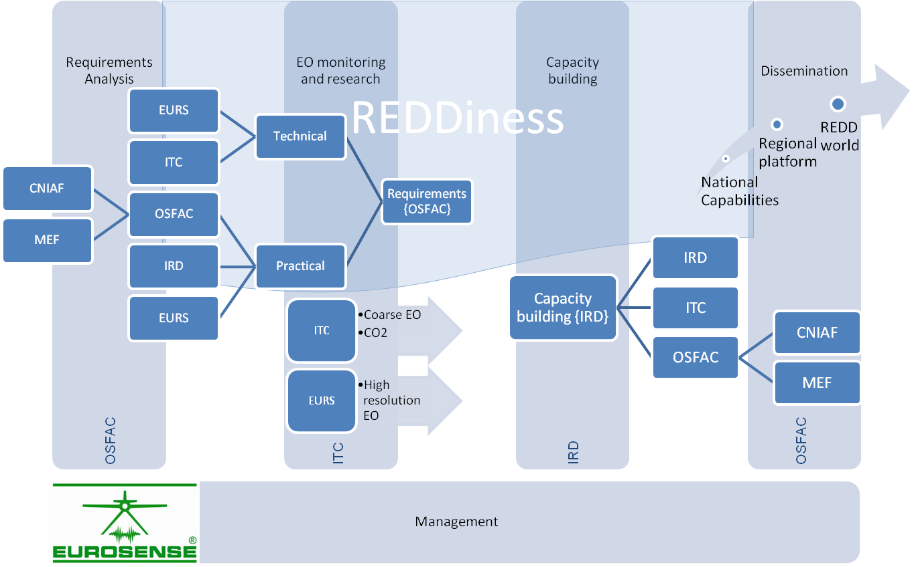
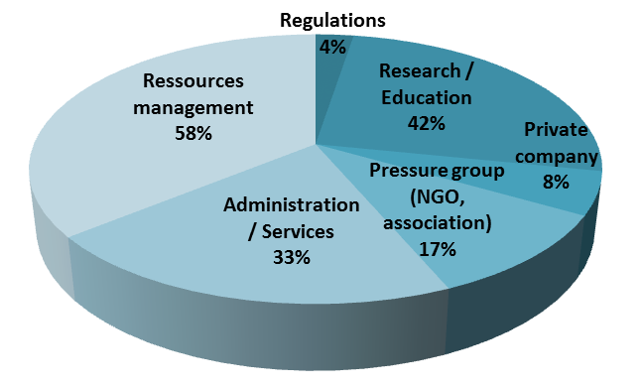
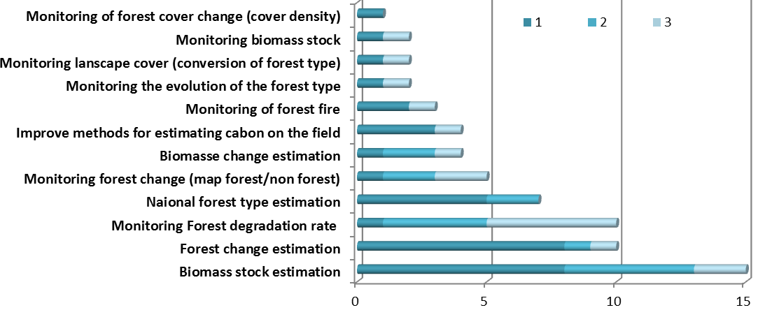
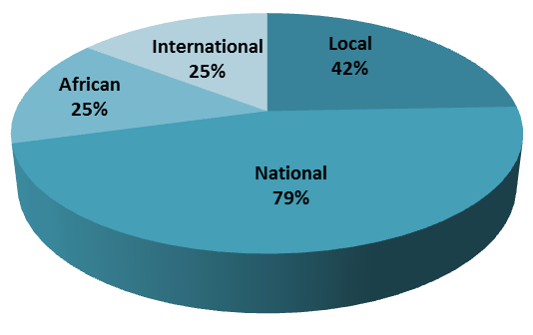
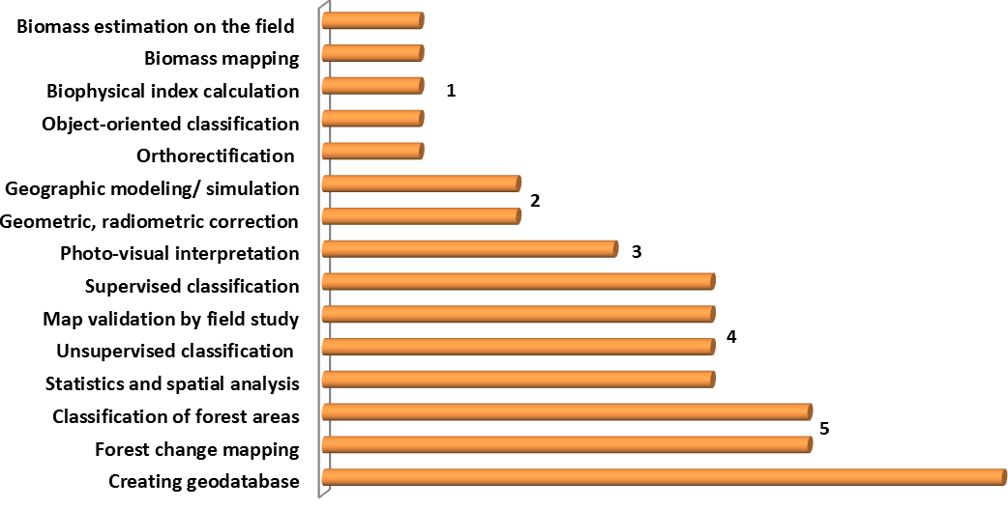
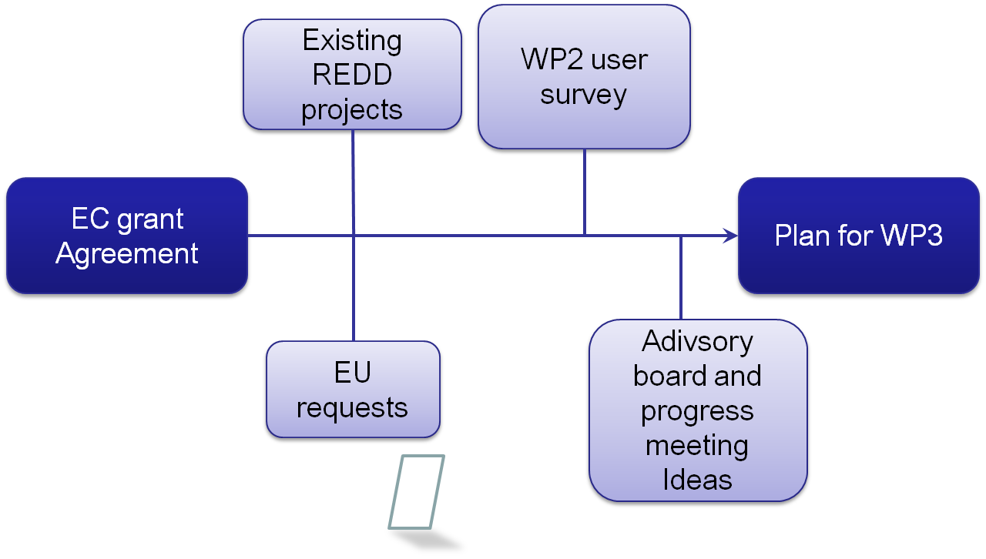
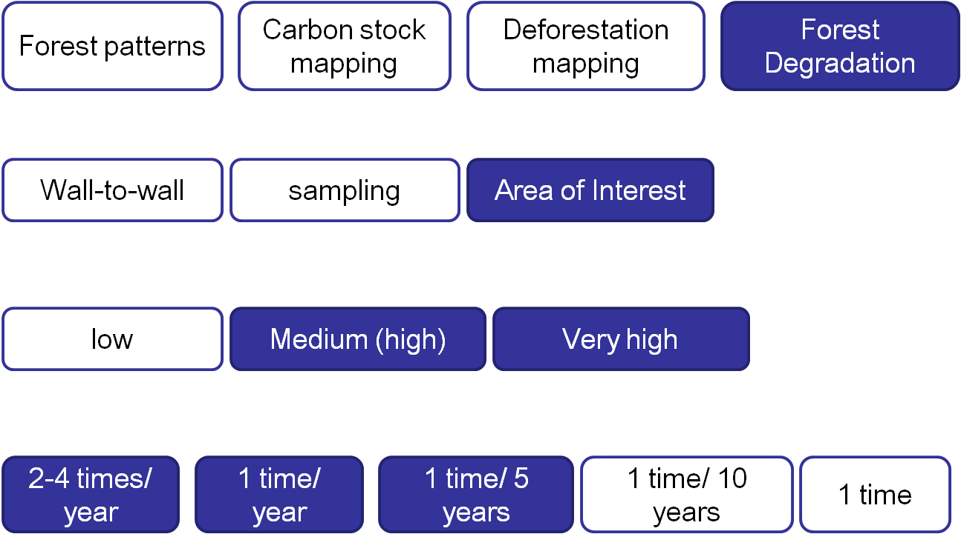
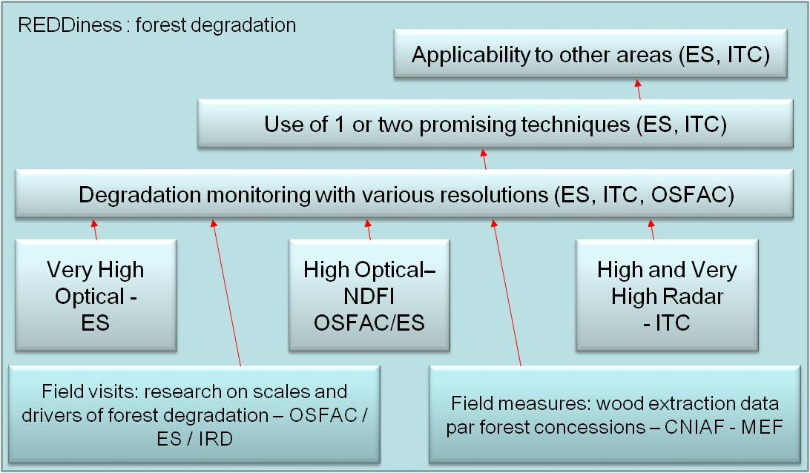







Support EO-driven forest monitoring in Central Africa
nathalie.stephenne@eurosense.com
http://www.reddiness.com
Preserving African forest contributes to Global climate change challenge. Earth Observation (EO)
techniques are essential in monitoring forest changes and supporting REDD (Reducing Emissions from Deforestation and forest Degradation) negotiations for climate change mitigation.
Users requirement analysis
State-of-the-art
The REDDiness approach refers to existing projects and initiatives in the Congo Basin. REDDiness responds to the EC call for increased collaboration between Africa and Europe within Specific International Cooperation Action (SICA).
International agreements on REDD must rely on operational national and regional forest monitoring systems that accurately measure, map, report and verify (MRV) timely changes in forest state and carbon emission. Up-to-date EO techniques are seen as essential tools in MRV systems. While regional or large remote sensing projects already exist in the region, REDDiness decided to focus on one specific topic less addressed by other initiatives : forest degradation.
Workflow of REDDiness : from Congolese and Gabonese user requirements to REDD world
Four main profiles of survey participants: Natural resources management / Education / Administration/ NGO’s
End-user questionnaire
Management levels of Congolese and Gabonese institutions: mainly national and regional, only 25% have a continental or international vision
A quantitative survey has been carried out in Republic of Congo and Gabon to measure awareness and interest
in EO-based products.
Despite a large interest in
REDD and EO training for MRV,
only 8 end-users have a minimum
technical understanding to learn these techniques.
“What are the 3 most importants EO techniques in your national REDD strategy?”
This technical understanding is defined by three criteria: (i) the level of knowledge in EO techniques, (ii) completeness of the responses and (iii) coherency in the answer to two overlapping questions. With these criteria we define 8 end-users among 24 as the best partners to define the REDD optimal EO techniques in Congo and Gabon. Personnel skills and technical resources to work with GIS and EO techniques have been assessed. EO software and competences are missing.
Interests and needs of training in EO techniques for forest and carbon monitoring
Criteria to define the technical understanding and select the 8 best REDDiness end-users
 | REDD knowledge |  |  | Completeness (/23 questions) | Consistency |  | Total (%) | REDD project
 | Pol. (/5) | Scient. (/5) |  |  | Set (/2) | Link (/1)
 | Congo
CNIAF | 3 |  | 3 | 23 | 2 | 1 | 87% | Yes
OCDH | 5 |  | 4 | 22 | 1.5 | 0.5 | 79% | Yes
CERGEC | 3 |  | 4 | 23 | 1 | 1 | 85% | No
CIB | 2 |  | 3 | 23 | 2 | 1 | 87% | No
 | Gabon
IRSH | 4 |  | 5 | 23 | 2 | 0.5 | 92% | No
MEF-Bois | 2 |  | 3 | 22 | 2 | 1 | 85% | Yes
MEF-Aqua | 3 |  | 3 | 23 | 2 | 1 | 87% | No
IRET | 3 |  | 3 | 23 | 2 | 1 | 87% | No
EO monitoring solutions
REDDiness did an in-depth analysis of the state-of-the-art to be able to support Congo and Gabon in the development of their MRV systems. From a large inventory of topics needed in MRV and EO expertise in REDDiness consortium, one specific scenario of EO monitoring has been chosen for the project : “forest degradation in cloudy region”.
Way to define the optimal EO monitoring methods (WP3) for REDDiness
Selection of REDDiness focus by surveying 4 main questions within the consortium
The “forest degradation” scenario defined for REDDiness is the result of a detailed processus of decision in the consortium. The state-of-the-art of existing projects, advices from scientific specialists, review of consortium expertises and the in-depth users survey help REDDiness to define some “niches” of interest in the MRV.
Each partner replied to 4 questions about the focus of REDDiness:
- Which main topic within the MRV?
- How to decide the study area ?
- Which Spatial resolution ?
- Which Time resolution (update…)?
Scenario of EO monitoring for REDDiness : “forest degradation in cloudy region”
Capacity building
Traditional houses in Swaziland.
In the second phase of REDDiness, capacity building practices in GIS, remote sensing and field analysis are planned. The EO monitoring and capacity building plans will be combined to optimise the transfer of knowledge in collaboration with other regional initiatives. On the long term, the two local partners of REDDiness (MEF and CNIAF) would be the key contacts for REDD national training.
REDDiness is an FP7 project, and is partially funded by the European commision. The project reflects only the author’s views and the Community is not liable for any use that may be made of the information contained herein.
EUR 2147/2011

